Slide 1
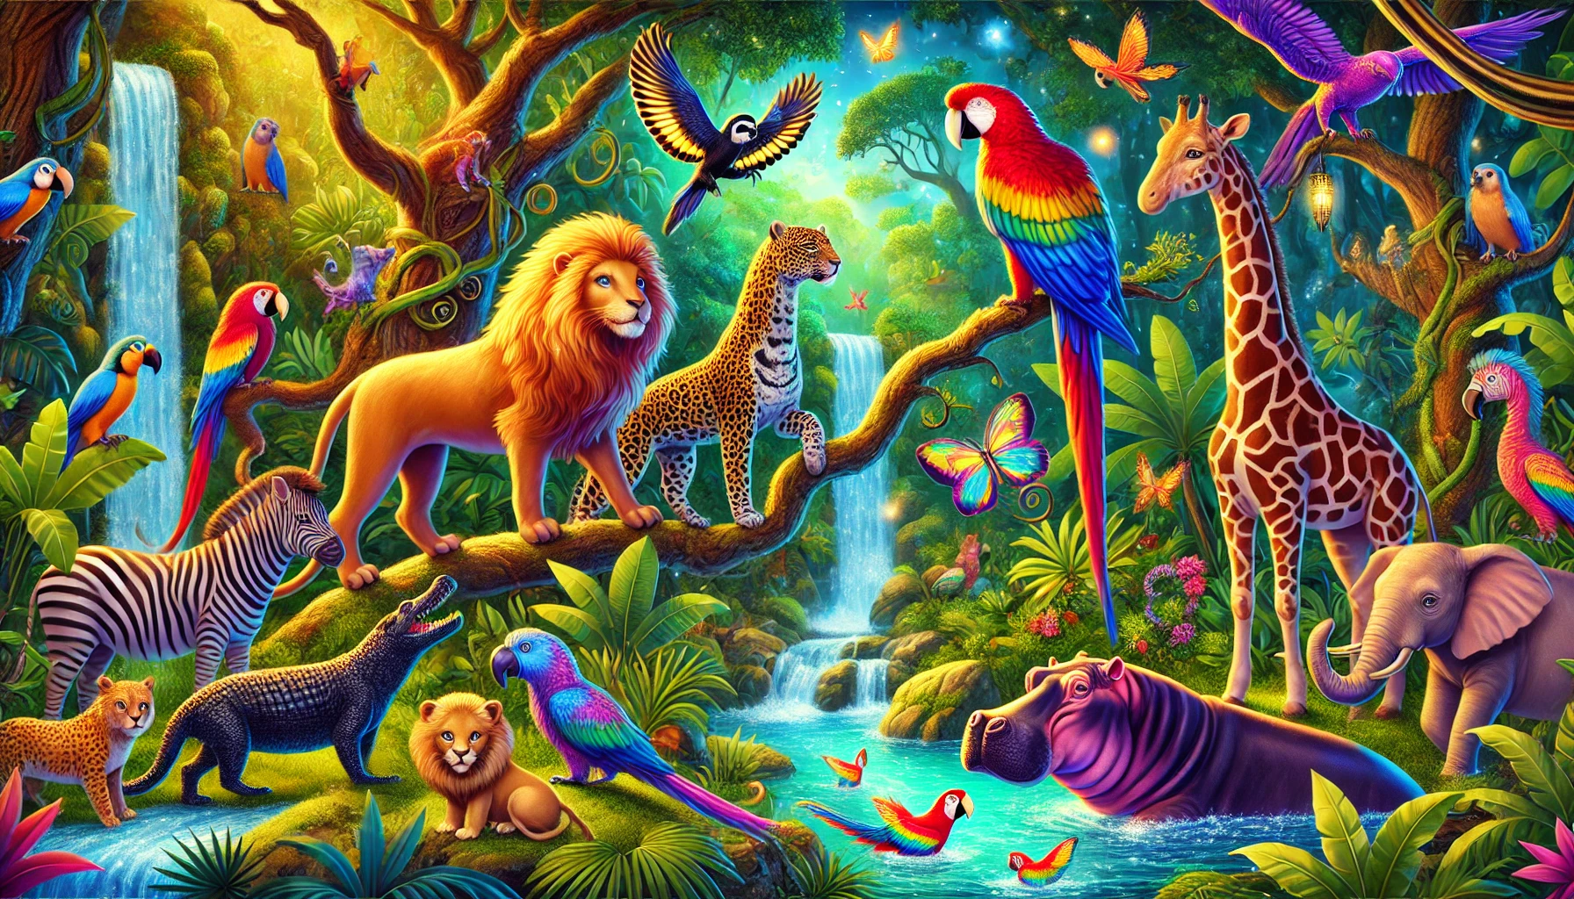
Little Jungle Artists
Coloring Book

Slide 2
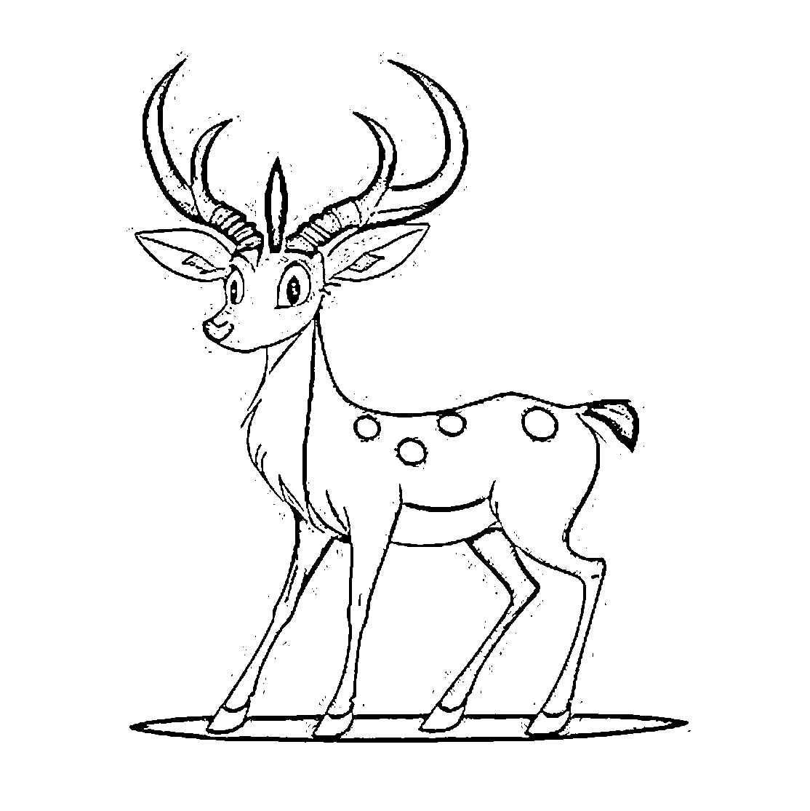
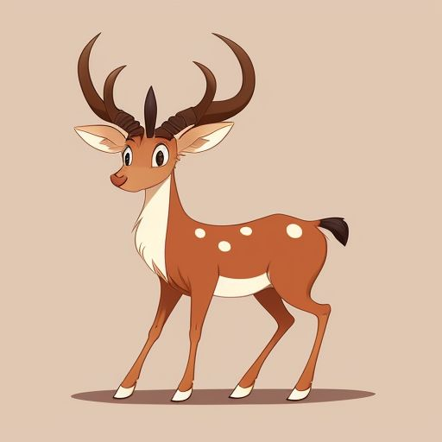
Trace & Color
Wild Animals
Antelope

Slide 3


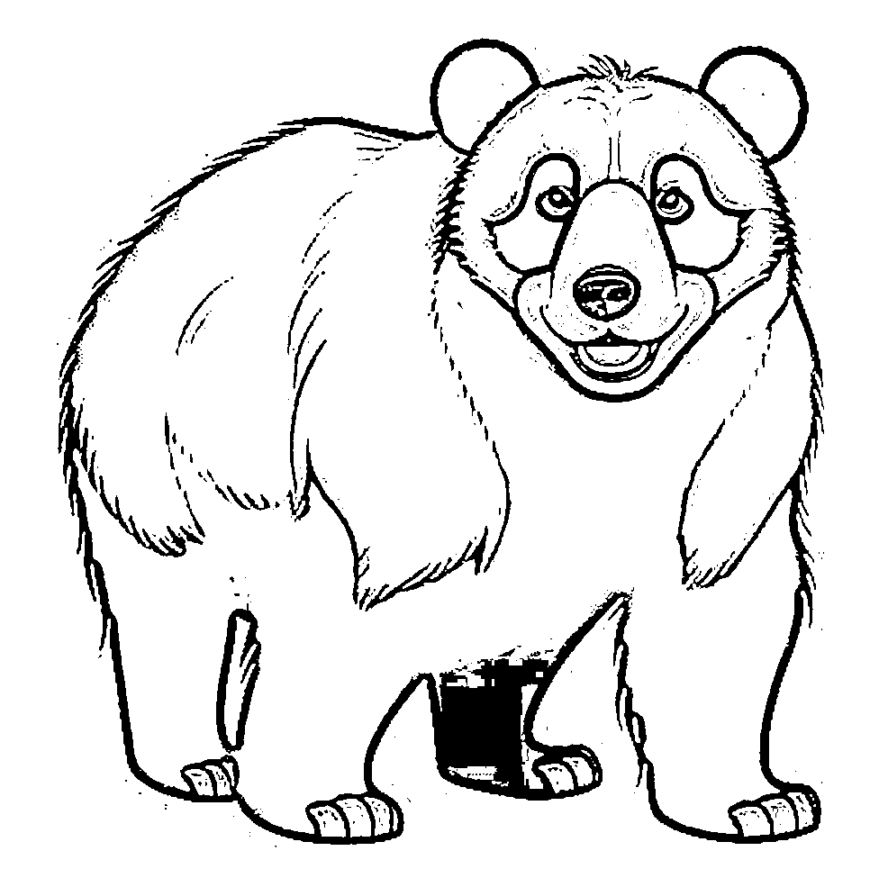

Trace & Color
Wild Animals
Bear

Slide 4
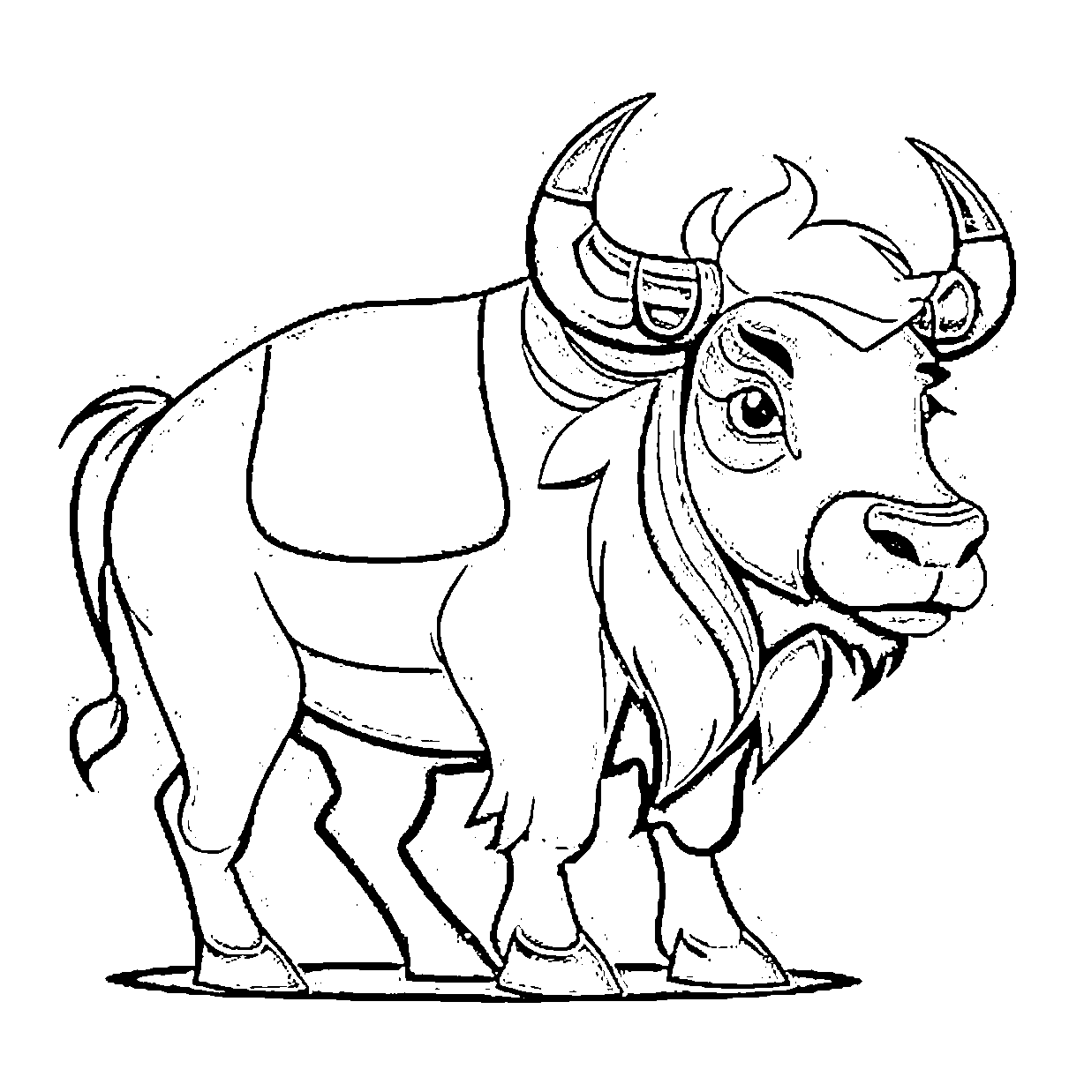
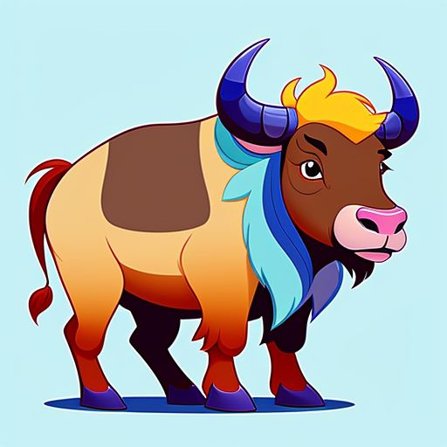
Trace & Color
Wild Animals
Buffalo

Slide 5


Trace & Color
Wild Animals
Rhino

Slide 6
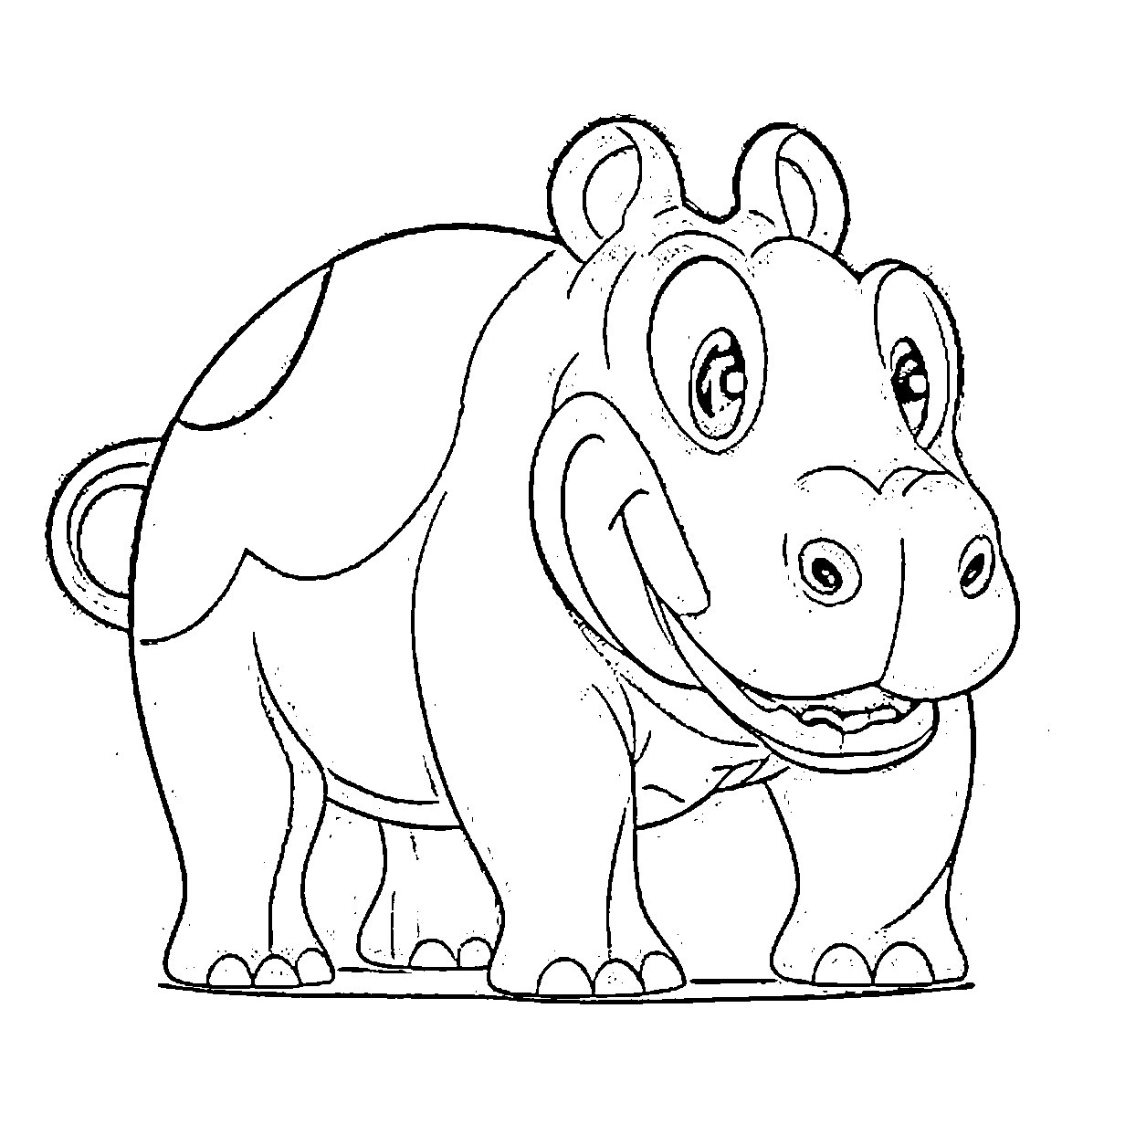
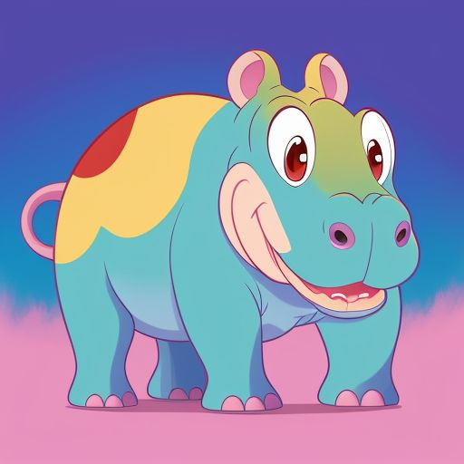
Trace & Color
Wild Animals
Hippopotamus

Slide 7
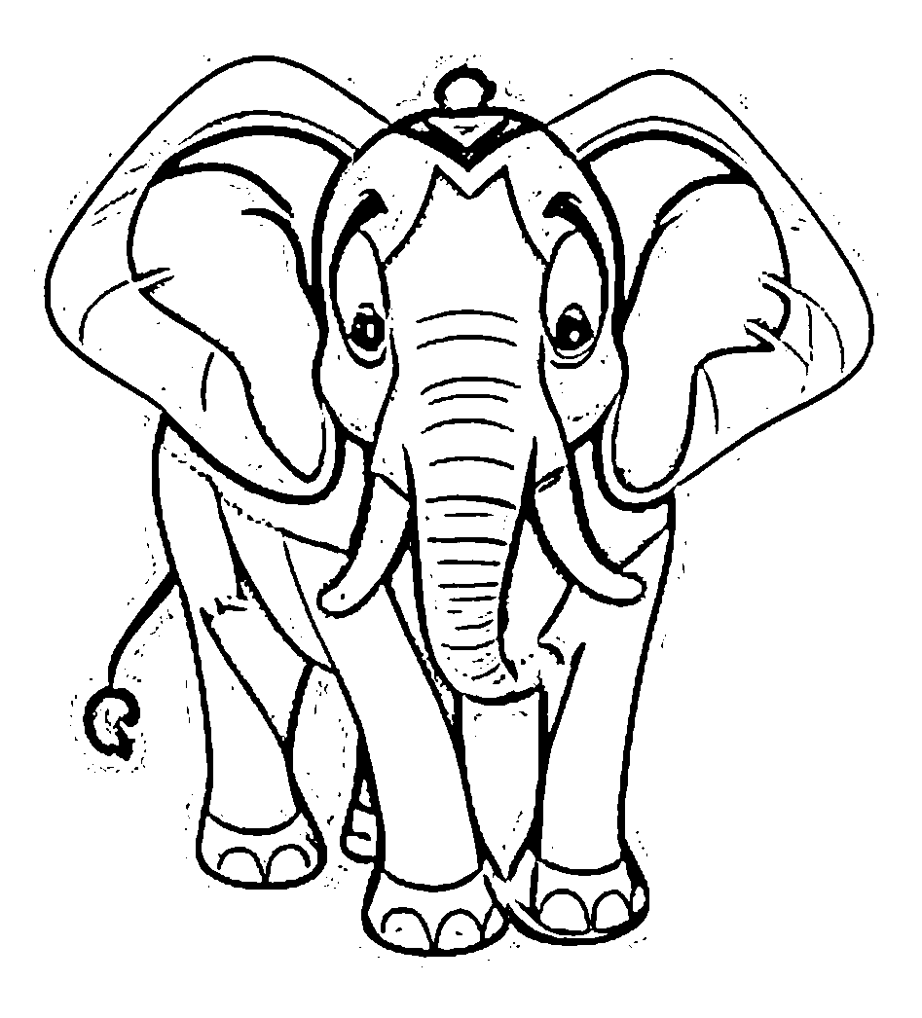

Trace & Color
Wild Animals
Elephant

Slide 8
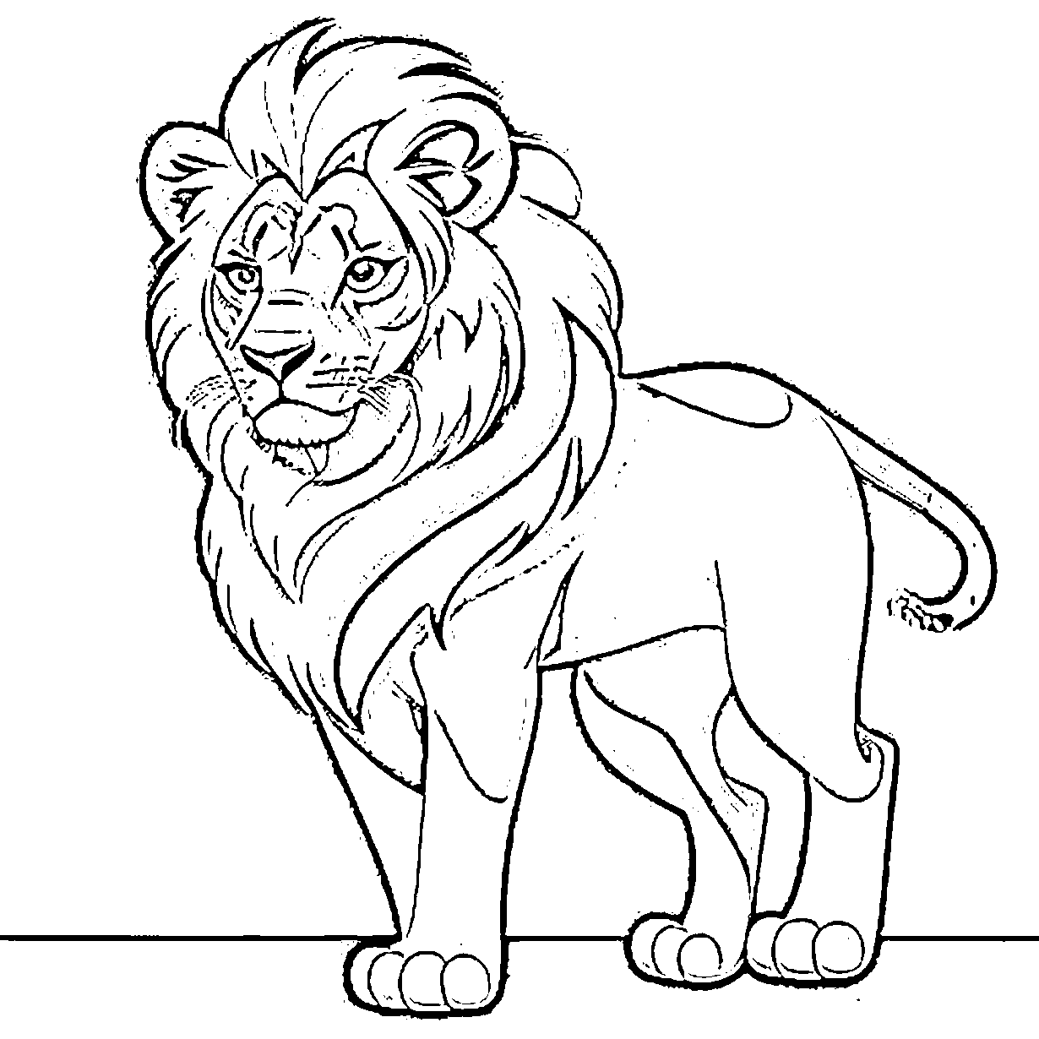

Trace & Color
Wild Animals
Lion

Slide 9
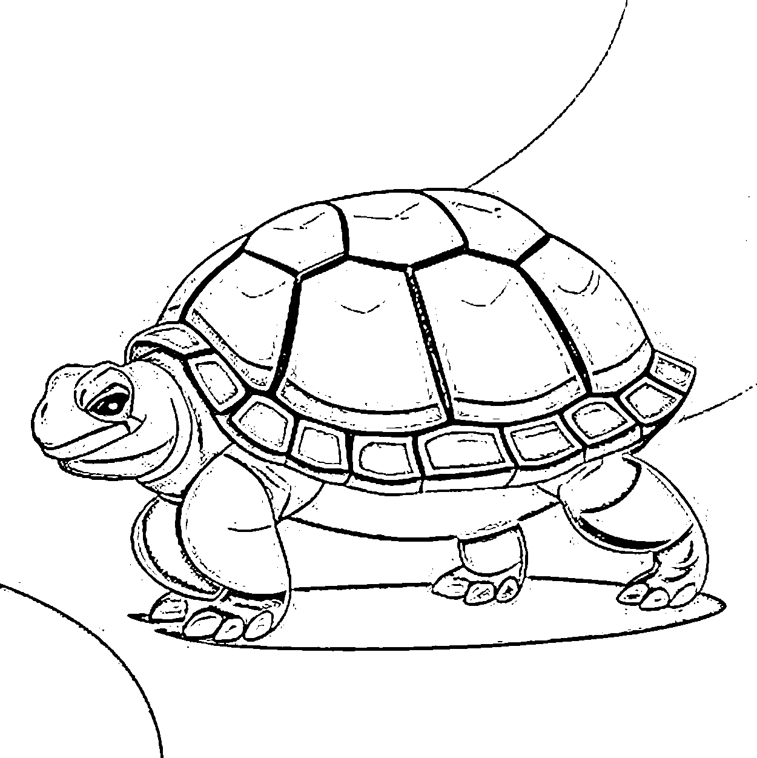

Trace & Color
Wild Animals
Tortoise

Slide 10
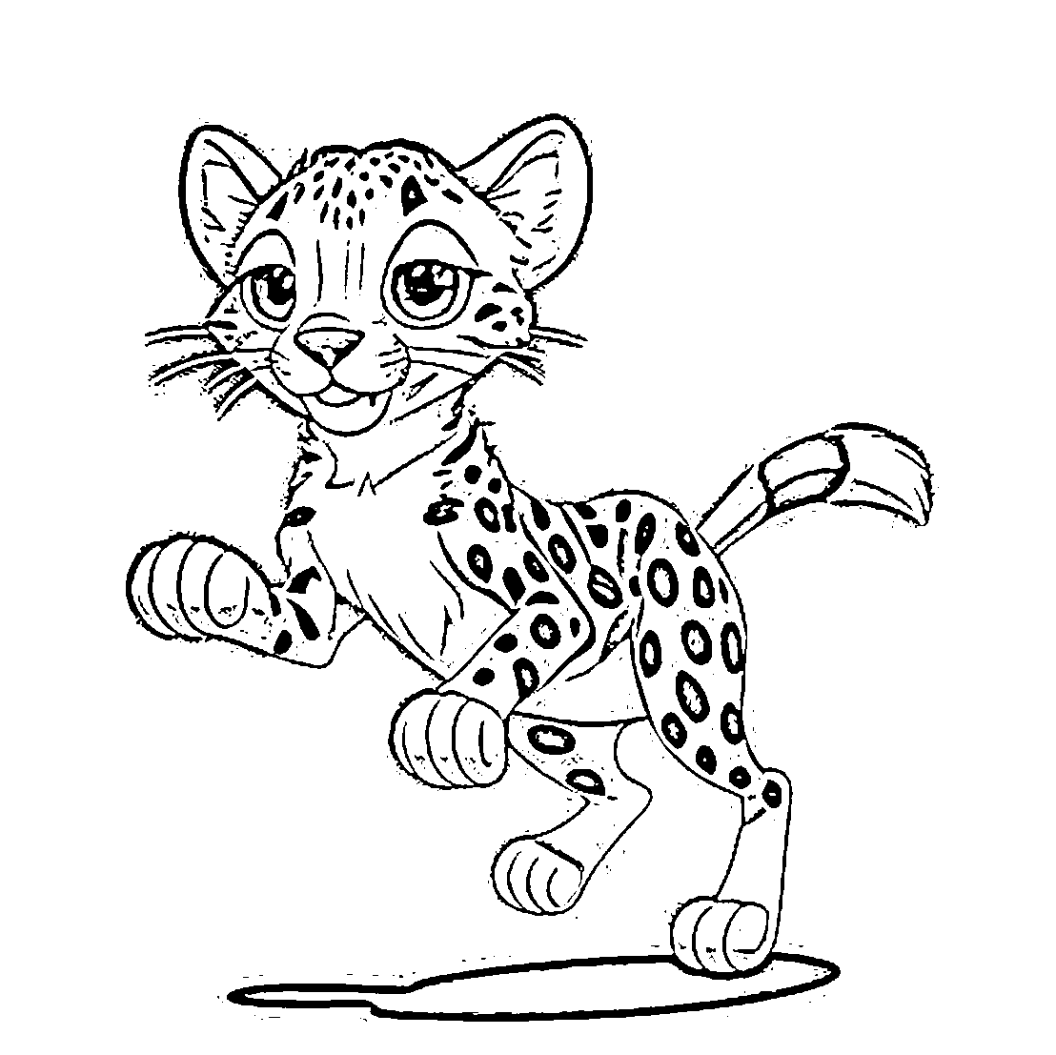

Trace & Color
Wild Animals
Cheetah

Slide 11


Trace & Color
Wild Animals
Tiger

Slide 12
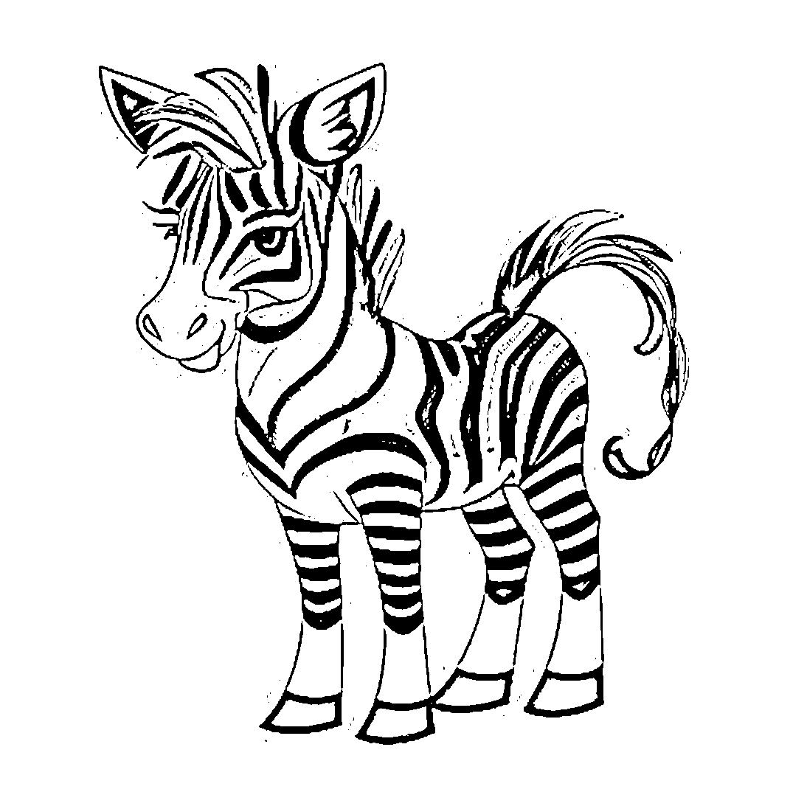
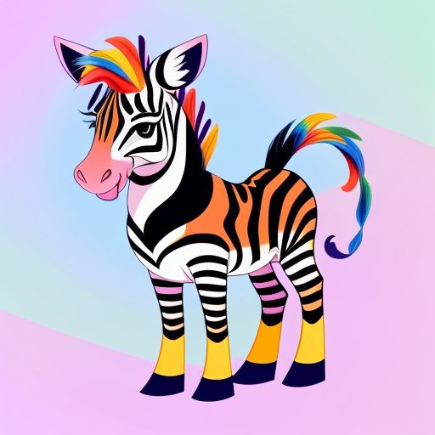
Trace & Color
Wild Animals
Zebra

Slide 13
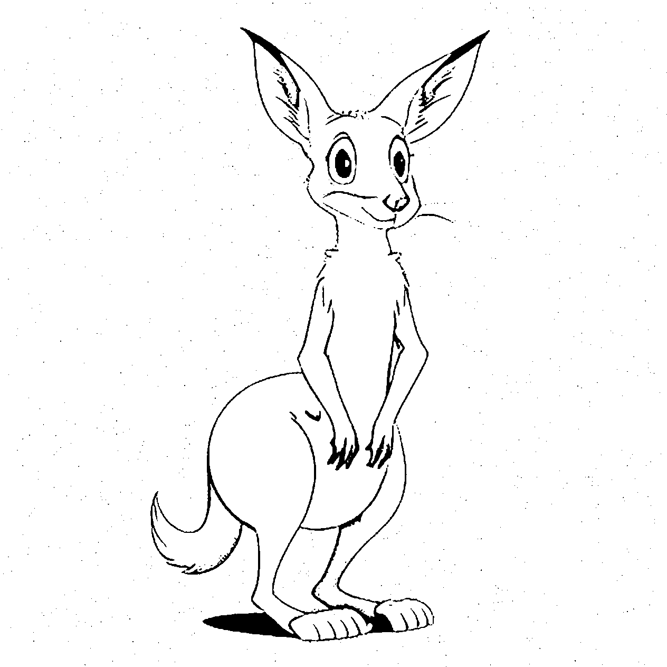
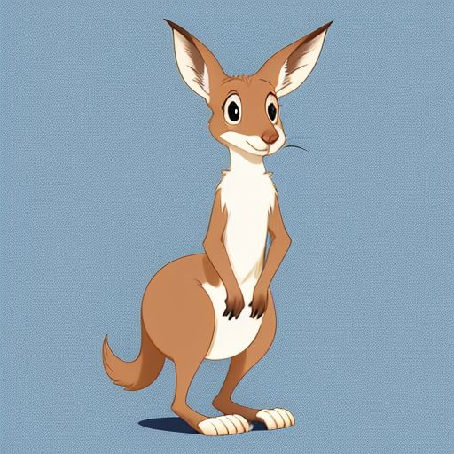
Trace & Color
Wild Animals
Kangaroo

Slide 14
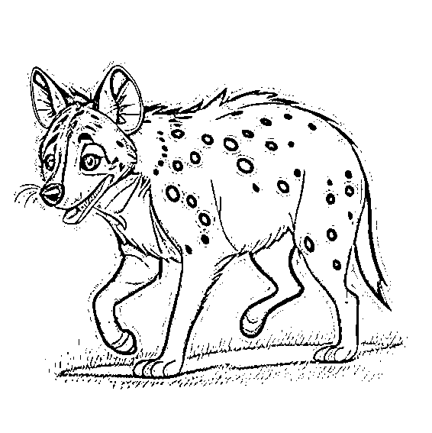
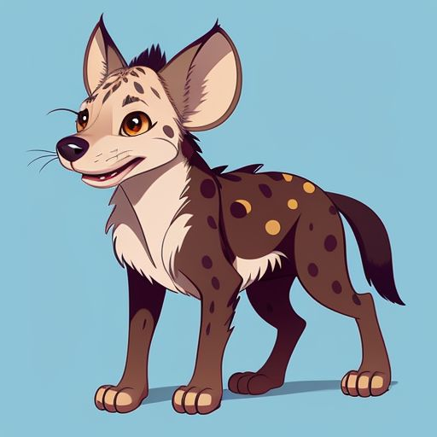
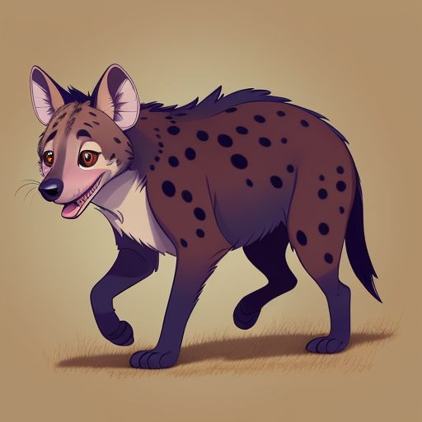
Trace & Color
Wild Animals
Hyena

